Slide 1
Qualys Features
Lets take a look at Qualys features

Slide 2
Qualys Features
Qualys:
Cloud-based service
On-premise device
Complete suite
Scalable and immediate deployment

Slide 3
Qualys Features
Qualys:
Asset discovery; find and organize hosts
Prioritize & manage remediation tickets
Continuous monitoring service
Policy compliance scanning
Qualys Secure Seal for websites

Slide 4
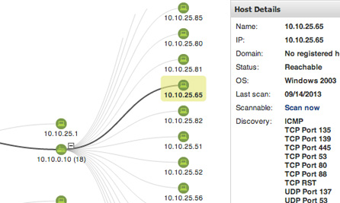
Qualys Features

Slide 5
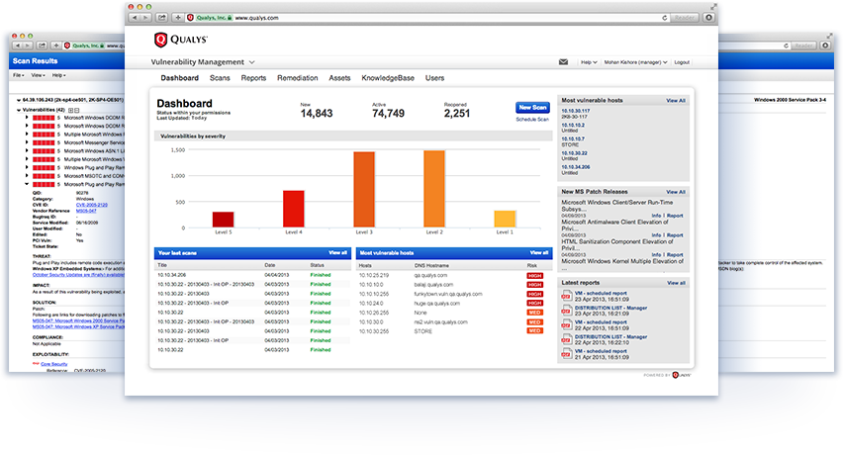
Qualys Features

Slide 6
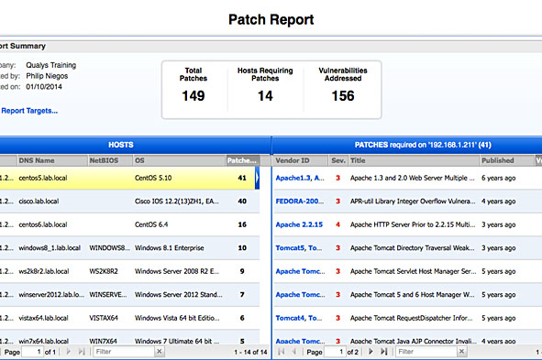
Qualys Features

Slide 7
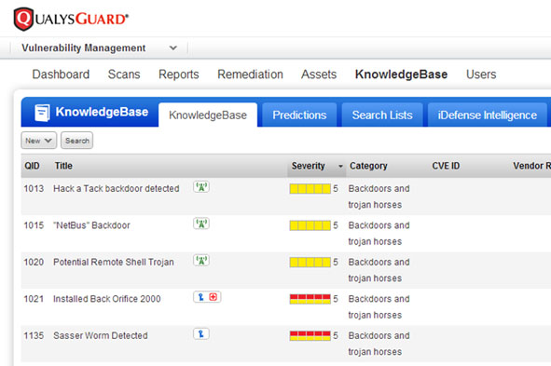
Qualys Features

Slide 8
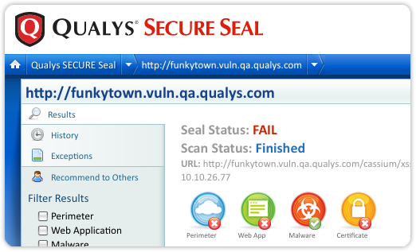
Qualys Features

Slide 9
Qualys Features
Qualys:
Website scanning
compliance
Annual subscription service model

Slide 10
Qualys Features
Qualys is a convenient and scalable VM tool that comes with several modules
Subscription-based pricing model which can be expensive
Several advantages due to cloud-based service

